Slide 1
SESSION 1
Introduction to RISE
Platform Intelligence, AI & Core Navigation
DURATION
FORMAT
60 min
Live demo + guided exploration

Slide 2
01
RISE
The paradigm shift — from product suite to integrated AI platform
02
Platform Structure
Menu, navigation, removal of 'products' — everything is connected
03
AI & Propensity Data
How RISE intelligence works and why richer contact data unlocks more
04
Dashboard deep dive
Opportunities, schedule, database health, and the AI Agent
05
Contacts deep dive
Overview, SmartGroups, tags, pipeline view, and contact records

Slide 3
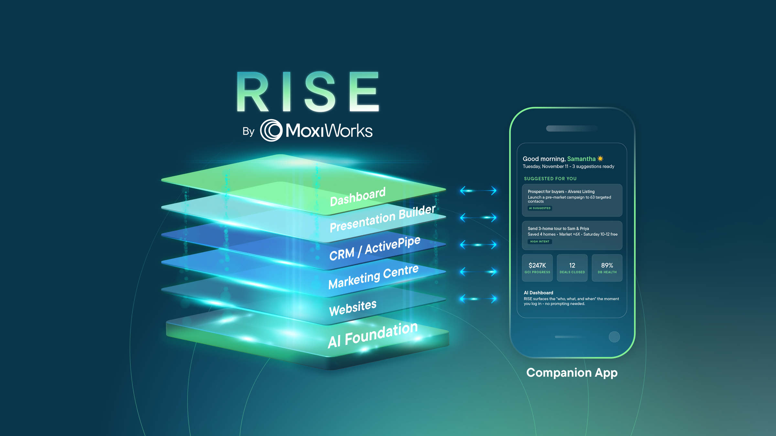

Slide 4
SESSION 1
In Product Demo
Dashboard and contacts deep dive

Slide 5
Recap
✓
RISE is an integrated AI platform
✓
AI propensity data transforms a database into a prioritized action list
✓
The Dashboard tells agents exactly who to contact and why every day
✓
The AI Agent is proactive (surfaces opportunities) and reactive (answers questions)
✓
Contacts with richer data → better AI scoring → better recommendations
✓
Pipeline view + SmartGroups make the contact database actionable

