Slide 1
AGENT SESSION
RISE
Getting started, AI features and working on the go
DURATION
FORMAT
60 min
Live demo + guided exploration

Slide 2
Agenda
01
Getting Started
Cover how to access RISE, navigation, settings, the Dashboard, RISE AI
02
Contacts and Getting Organized
Contacts, Tags, SmartGroups, Tasks and Workflow Stages
03
Creating and Sharing
Creating an Email, starting a Pre-built Campaigns, AI Features
04
Presentations & Mobile App
Creating Presentations, Canva integration, accessing and using the mobile app
05
Questions & FAQs
Live Q&A and session wrap-up

Slide 3
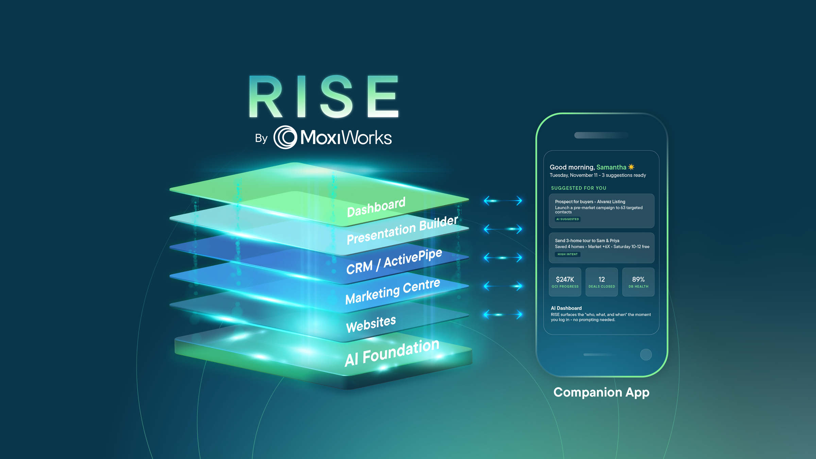

Slide 4
AGENT SESSION
In Product Demo
From logging in to advanced AI features it’s time to dive in.

Slide 5
Wrap-up & Resources
✓
Courses: education.moxiworks.com
✓
Knowledge Center: rise-moxiworks.zendesk.com
✓
Product feedback: feedback.moxiworks.com
✓
RISE with Us Podcast: https://fast.wistia.com/embed/channel/6e7ex9tnyu

